Slide 1
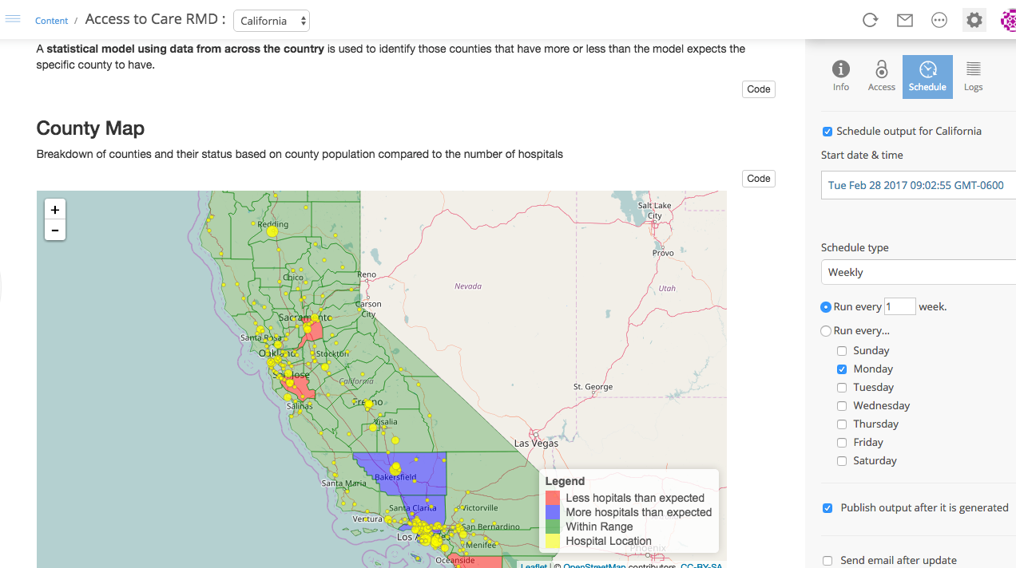

Communicating effectively using RStudio Connect
2017

Slide 2
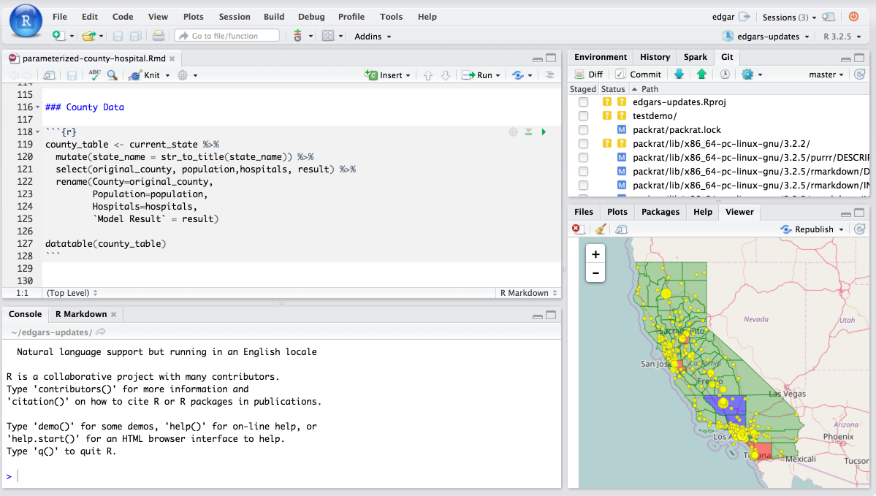


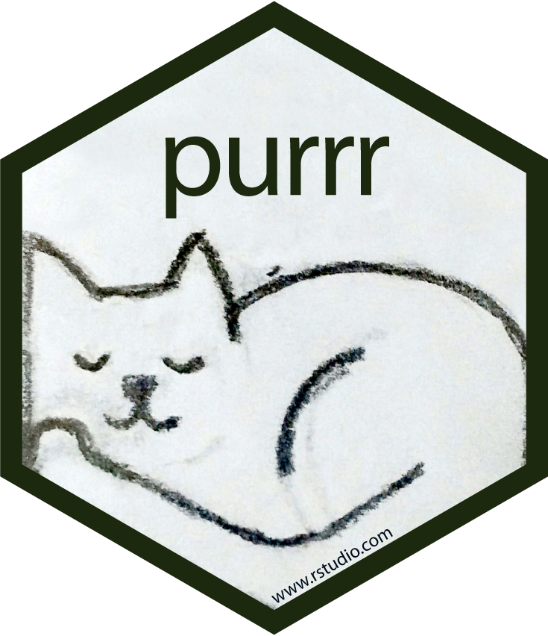


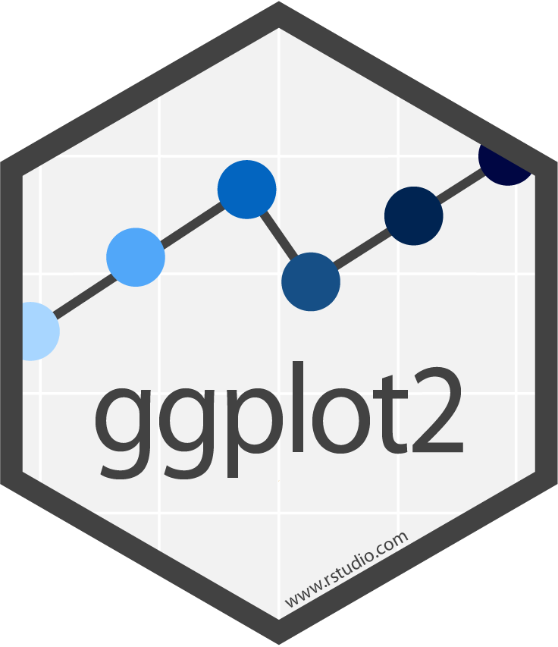
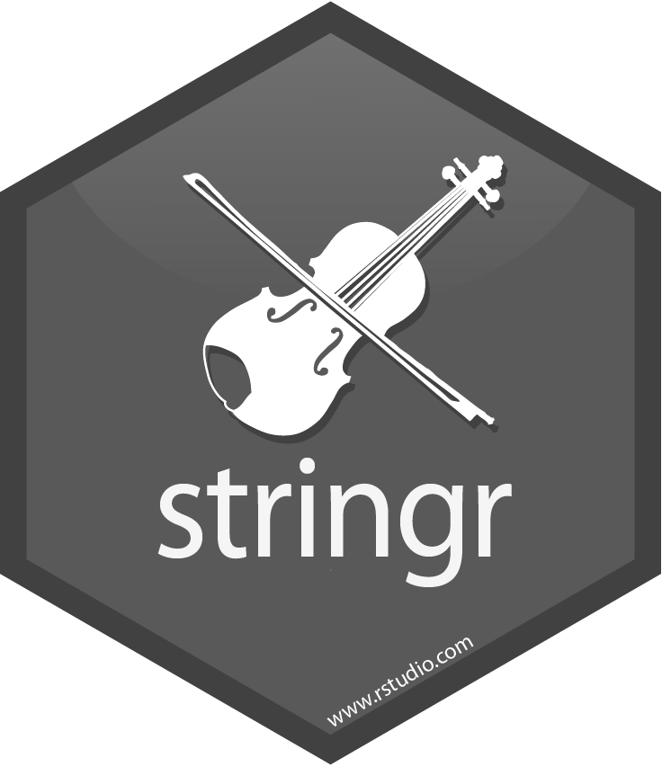
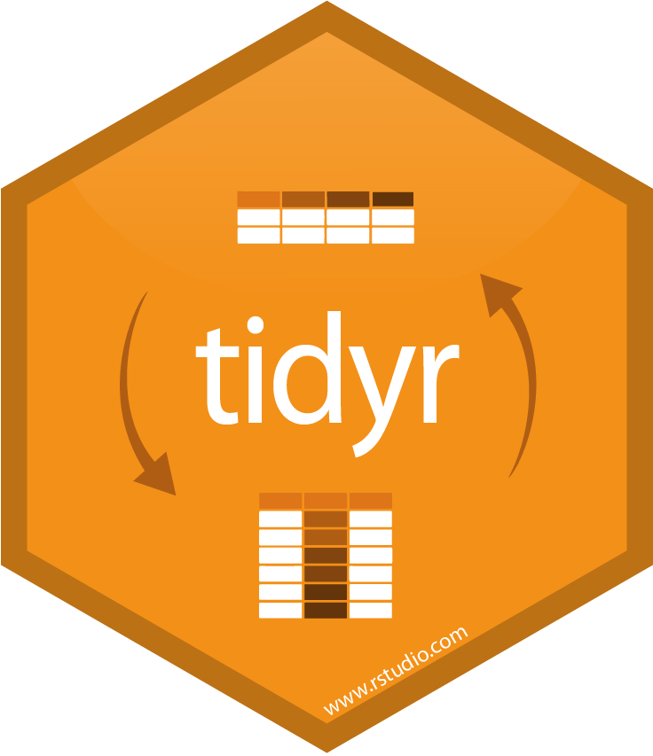

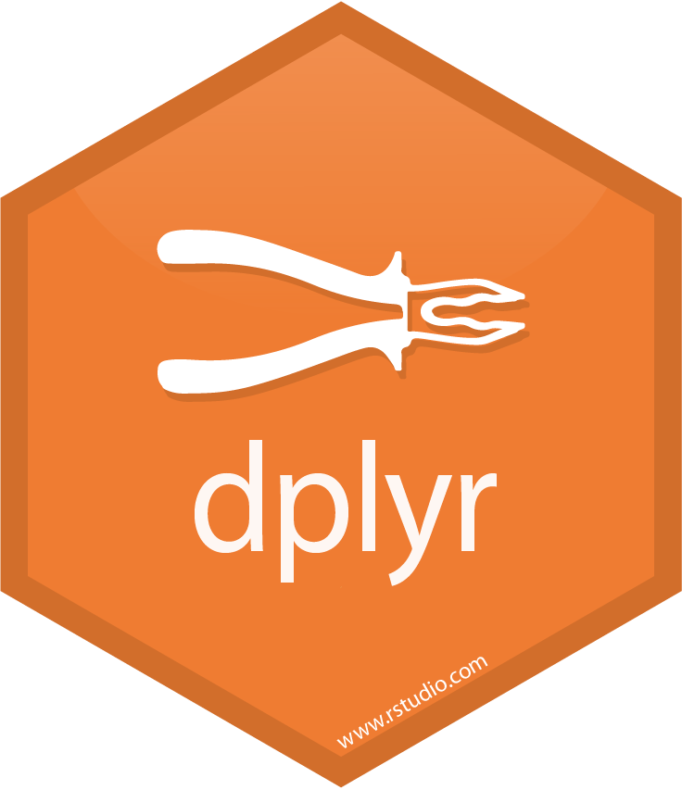


Introduction
RStudio IDE
RStudio Connect
Packages
Notes:
Add Connect, tidyverse and comments about artifacts

Slide 3





Create insights with Data Science
0
0
Data Sources
Visualize
Import
Tidy
Transform
Communicate
Model
Understand
R for Data Science, Wickham & Grolemund
Notes:
This is how we think about Data Science
The hoped outcome of this process are ‘actionable insights’
The person who produces the insight is called ‘Creator’
The creator uses R from beginning to end

Slide 4

The Creator
Data Scientists who use R to analyze data
Who are they?
Creator
What are they trying to accomplish?
Understand the data
Share findings
Notes:
Important to define who the Consumer is because we need to understand their motives to use our analyses
Key - Consumers are not trying to ‘consume’ the artifact, they are trying to consume the ‘insight’ you achieved
This is not an easy task

Slide 5
The Consumer
The audience:
Manager
Peers
Students
Who are they?
Consumer
What are they trying to accomplish?
Make a decision
Learn something
Notes:
Important to define who the Consumer is because we need to understand their motives to use our analyses
Key - Consumers are not trying to ‘consume’ the artifact, they are trying to consume the ‘insight’ you achieved
This is not an easy task

Slide 6
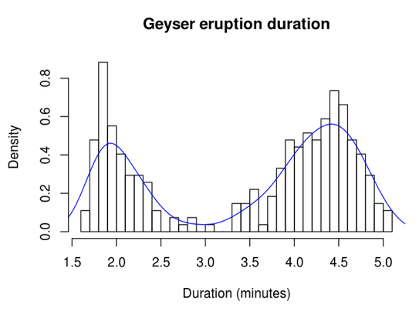
The Common Workflow
Creator
Artifact
Consumer
Notes:
There’s a workflow that starts with the Creation process
A very common workflow we see is for a Creator to build an Artifact (like a plot) and share it with Consumer
There are many ways of how companies share the Artifact:
Place the artifact in a share drive or a portal (SharePoint)
Paste the artifact to another analysis or presentation tool (not gonna say Excel or PP ☺)
Email to the consumer (most common)
Question to audience – How many have 100% of your artifacts in a place where your consumer can easily access them? Then ask: 75%, half, just a couple…

Slide 7
Two Stories
Artifact
Creator
Consumer
Creator Story
Consumer Story
Notes:
Sharing ‘static’ artifacts creates a problem
It isolates the creator and consumer into their own respective bubble or story
This is caused because a ‘static’ artifact does not allow the consumer to ‘dig deeper’ without having to start the process again
Question to audience (rhetorical) - How many of us spend two hours at the beginning of the month creating an analysis, and the rest 30 days and 22 hours answering questions about it?

Slide 8
The two story problem
Question
Artifact
Creator
Consumer
Creator Story
Consumer Story
Notes:
Sharing ‘static’ artifacts creates a problem
It isolates the creator and consumer into their own respective bubble or story
This is caused because a ‘static’ artifact does not allow the consumer to ‘dig deeper’ without having to start the process again
Question to audience (rhetorical) - How many of us spend two hours at the beginning of the month creating an analysis, and the rest 30 days and 22 hours answering questions about it?

Slide 9
A story
Artifact
Creator
Consumer
Question
One Story
Notes:
A better story is to allow the consumer interact with the artifact to ‘dig deeper’
This means we also have to make better (as in: more sophisticated, complex) artifacts available to the consumer
“Self-service” BI

Slide 10
RStudio Connect
Demo - Plot

Slide 11
RStudio Connect
Demo - Document

Slide 12
RStudio Connect
Demo – Shiny App

Slide 13



RStudio Connect[s] Consumer & Artifacts
RStudio Connect
Creator
Consumer
Explore
Interact
Share
Schedule
Personalize
tidyverse
Secure
Email
Notes:
Creator uses R and the tidyverse to create the insight
The creator publishes an artifact created in RMarkdown or Shiny to RSC
In RSC you can Share, Secure, Email and Schedule updates to the published artifacts
The Consumer simply uses a web browser to explore, interact and personalize the asset

Slide 14
R for Data Science Toolchain
Data Sources
R
RStudio
Connect
Import
Tidy
Understand
Communicate
Publish
Notes:
We’ve formalized this conception of data science like this
RSC – The cure for the ‘common workflow’ ☺

Slide 15
List all demos here:
Plots
Documents
Apps
Parameterized docs
Scheduling
Email
Security
Tuning
UI
Home page
Notes:
Plots
Documents
Apps
Parameterized docs
Scheduling
Email
Security
Tuning
UI Driven

